Slide 2
Module Objective
Upon completion of this module, participants will understand disaster search operations including geo-referencing, search definitions and search markings.

Slide 3
Enabling Objectives
Understand and utilize the U.S. National Grid as a geo-referencing system for land SAR responders
Understand and utilize search strategies and definitions necessary in SAR operations
Understand and utilize standardized disaster SAR marking systems

Slide 4
Unit 1
U.S. National Grid
(USNG)

Slide 5
Terminal Objective
Upon completion of this unit, participants will be able to understand and utilize the U.S. National Grid as a point reference system to identify locations and document required information.

Slide 6
Enabling Objectives
Successful participants will understand;
Importance of a single point reference system for all land SAR responders
U.S. National Grid as a geo-referencing system for land SAR responders
How to identify specific locations on a map
How to report and document required point reference locations

Slide 7
“The USNG is intended to create a more interoperable environment … by establishing a preferred nationally-consistent grid reference system.”
CATASTROPHIC INCIDENT SEARCH AND RESCUE (CISAR) ADDENDUM
to the National Search and Rescue Manual
Version 1.1 (August 2008)

Slide 8
CISAR Addendum & the USNG
AHJ may determine which geographic reference system will be used
Selected geographic reference system should be listed in the Incident Communications Plan (Form ICS 205)

Slide 9
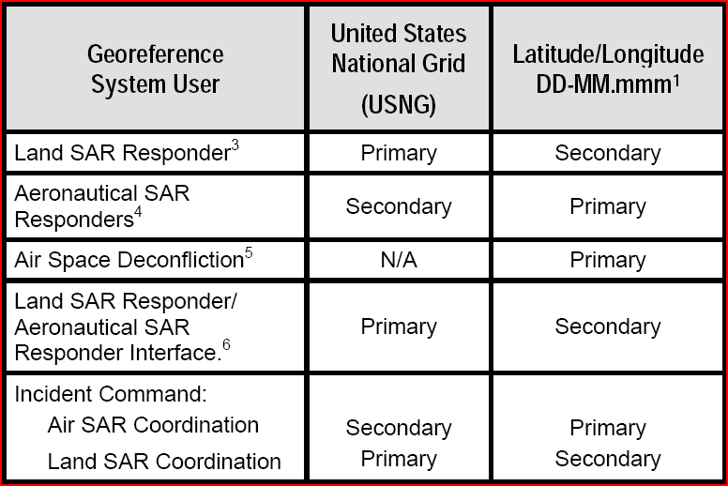
National SAR Committee
CISAR Geo-referencing Matrix

Slide 10
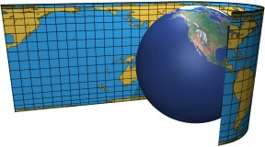
US National Grid Coordinate
What does the USNG Coordinate look like?

Slide 11
USNG Coordinate - Complete
GridZone
Easting (right)
Northing
(up)
100k square
14R NQ 82100 09500
Pre-Designated
Meters between 0-99,999

Slide 12
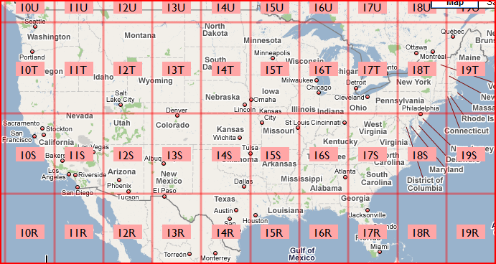
Grid Zone Designation (GZD)
14R NQ 82100 09500

Slide 13
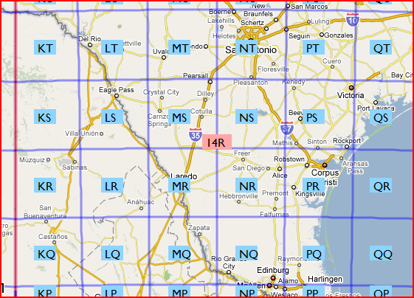
100,000 Meter Square (regional area)
14R NQ 82100 09500

Slide 14
USNG Accuracy
Accuracy is determined by amount of precision in coordinate (Easting and Northing)
Coordinate values represent a point position (southwest corner of grid square)
4 digits: 82 09 Identifies a point within a 1,000m square
(approx: 250 acres or 100 city blocks)
6 digits: 821 095 Identifies a point within a 100m square
(approx: football field)
8 digits: 8212 0952 Identifies a point within a 10m square
(approx: parking spot)- grid reader needed
10 digits: 82125 09525 Identifies a point within a 1m square
(approx: manhole cover)- GPS needed

Slide 15
USNG Coordinate Communication
The USNG coordinate identifies both:
  Point Position: intersection of coordinate (most common)
  Area: grid square NE of point position
Users determine the required precision
The USNG coordinate can by truncated, i.e.:
“821 095” instead of “82100 09500“
GPS devices require full coordinate string

Slide 16
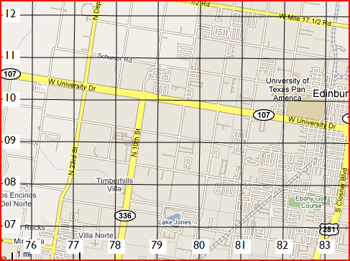
Read RIGHT (Easting) → then UP (Northing) ↑
14R NQ 82100 09500
1,000 meter accuracy
(4 digits)
This point identifies the USNG coordinate
Grid square (1000m x 1000m), up and right of coordinate

Slide 17
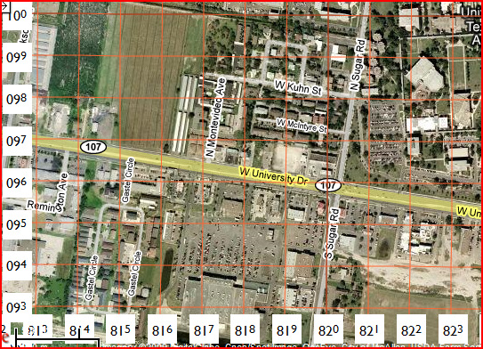
Read RIGHT (Easting) → then UP (Northing) ↑
14R NQ 82100 09500
100 meter accuracy (6 digits)

Slide 18
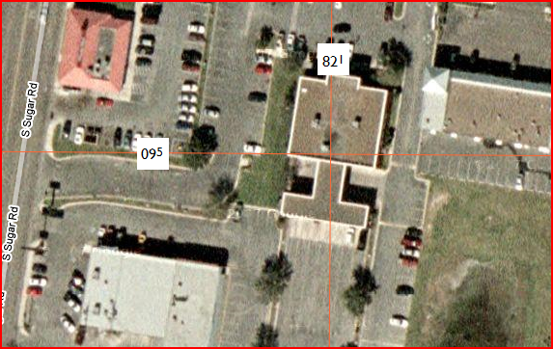
Read RIGHT (Easting) → then UP (Northing) ↑
14R NQ 82100 09500
10 meter accuracy (8 digits)

Slide 19
USNG in Disaster Response
Can be used to assign areas of responsibility without defined boundaries
  tasking to ‘search proximity’ around coordinate
Coordinate point position can define:
Survivor location
Base of Operations
Address of significance
Landing Zone (LZ)
Survivor Collection Point
Hazards
Vehicle location
Other?

Slide 20
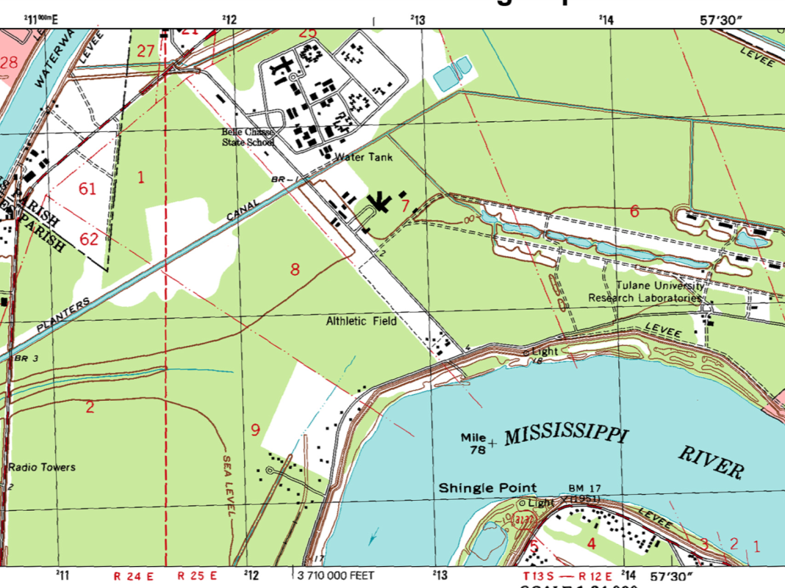
11
11
10
10
Mississippi River
13 09
09
09
up
right
What is the major feature at grid coordinate 13 09?
  4 digits (2x2): 1,000m accuracy
  Grid Square is approx. ½ mile in length or approx. 250 acres
  GPS would report this coordinate as 16R BU 13000 09000

Slide 21
11
11
10
10
09
09
Could 125 098 be used as a potential Landing Zone (LZ)?
  6 digits (3x3): 100m accuracy
  Grid Square is approx. length of football field
  Leading zero is needed (GPS would report this as 16R BU12500 09800)

Slide 22
Tulane University Research Laboratories
11
11
10
10
09
09
Would you require a Hazmat check before searching grid coordinates 145 099?
  6 digits (3x3): 100m accuracy
  Grid Square is approx. length of football field
  GPS would report this coordinate as 16R BU 14500 09900

Slide 23
11
11
135 098
10
10
09
09
What is the 6 digit grid coordinate for Channel Light 18?
  6 digits (3x3): 100m accuracy
  Grid Square is approx. length of football field
  GPS would report this coordinate as 16R BU 13500 09800

Slide 24
11
11
125 108
10
10
09
09
What is the 6 digit grid coordinate for the water tank?
  6 digits (3x3): 100m accuracy
  Grid Square is approx. length of football field
  GPS would report this coordinate as 16R BU 12500 10800

Slide 25
11
11
1000 meters
128 106
10
10
09
09
Is there potentially shelter available 360 meters to the Southeast of the water tank?
What is the coordinate for that location?
  What would a GPS report for this coordinate?
16R BU 12800 10600

Slide 26
Summary
Multiple SAR agencies used a variety of geo-referencing systems during Hurricane Katrina, causing confusion.
USNG geo-referencing scheme is to be used when a Catastrophic Incident is declared as outlined in the National Response Framework (January, 2008).
Additional information and training concerning the USNG can be found online. http://www.fgdc.gov/usng

Slide 27
Unit 2
Search Definitions and Standards

Slide 28
Terminal Objective
Upon completion of this unit, participants will be able to understand and utilize the search strategies and definitions necessary to accomplish the assigned search and rescue objectives.

Slide 29
Enabling Objectives
Successful participants will understand:
  Standard search definitions
  Search modes
  Phases of disaster search operations

Slide 30
Recon
Structured and organized survey
Preliminary and cursory check of an area
Immediate and continuous
Incident driven and flexible
Timely reporting of information

Slide 31
Recon Methods
Air
  Helicopter
  Fixed wing
  Satellite imagery
Water
Windshield survey

Slide 32
Purpose of Recon
Determine scope and magnitude of incident
Identify resources needed
Record victim location
Request rescue resources

Slide 33
Recon Team Configuration
Incident driven
Small
Mobile
Flexible
Inconspicuous (where possible)

Slide 34
Psychology of Recon
Recon is a state of mind
  Do the most good for the most people
  First snapshot of entire event
  Drives the response effort
Recon is triage…NOT search or rescue!

Slide 35
Hasty Search (Rapid)
Fast-paced search to locate and remove lightly-trapped survivors with available equipment
  survivors moved to collection points
Additional resources called for survivors unable to be removed while search continues
Documentation of areas searched and finding must be recorded and reported

Slide 36
Primary Search
Quick search of structures likely to contain victims…looking in, not going in
May include physical, canine and technical
Additional resources called for trapped survivors while search continues
May perform actions necessary to immediately correct life threatening injuries
Survivor and/or human remains locations marked with standard marking systems

Slide 37
Secondary Search
Systematic search of every area of every structure
May involve extensive debris removal
  Low Coverage: search void spaces
  High Coverage: complete de-layering
Additional resources called for trapped survivors while search continues
Survivor and/or human remains locations marked with standard marking systems

Slide 38
Recon
SEARCH
Hasty
SEARCH
Primary
Secondary

Slide 39
Special Response Team
Deployed to investigate pre-identified facilities that are likely to require evacuation assistance
Hospitals
Nursing Homes
Evacuation Shelters
Critical Infrastructure Facilities
Areas of last refuge such as fire stations and police precincts

Slide 40
Remember!
The AHJ has the authority to modify these definitions.
Modifications must be clearly stated.
Search definitions must be made available to all team members assigned to the incident.

Slide 41
Other SAR Terms
Structural Collapse SAR
Wide Area SAR
Evacuation
Extraction
Extrication
Detection
Location

Slide 42
Search Phases
I | Recon | Intelligence gathering
II | Hasty | Surface survivors removed and evacuated
III | Primary | Searching accessible voids that may contain survivors
IV | Secondary | Selected debris removal. Extended operations required to extricate survivors
V | Search completed | General debris removal

Slide 43
Summary
Understanding and utilizing the search strategies and standard definitions is necessary to accomplish the assigned search and rescue objectives.

Slide 44
Unit 3
Search Marking Systems

Slide 45
Terminal Objective
Upon completion of this unit, participants will be able to understand and utilize standardized disaster search and rescue marking systems.

Slide 46
Enabling Objectives
Successful participants will understand and be capable of utilizing the follow standardized disaster marking systems:
Grid and Block Marking System
Structure Hazard Evaluation Marking System
Structure/Hazard Marking System
Survivor and Human Remains Marking Systems

Slide 47
Grid and Block Marking
Use existing hundred block. Even numbers on one side, odd numbers on other side
Mark new numbers on the front with orange spray paint.
Street not identifiable, start with the letter “A” using the phonetic alphabet “Alpha”, “Bravo”, Charlie, etc.

Slide 48
702 704 708 710
706
701
703 705 707 709
700 block of Alpha St

Slide 49
Side and Floor Identification
Street side is ‘A’. Rotate clock-wise
SIDE C
SIDE
B
SIDE
D
SIDE A
700 Block Alpha Street
Multi-story structures
    Ground floor: Floor 1
    Second Story: Floor 2
    Basement, floors below ground: B-1

Slide 50
Structure Markings
Arrow indicates direction of safest entry
Structure relatively safe
Structure is significantly damaged
Hazardous materials in or near the structure
HM
15JUN92
HM NATURAL GAS
OR–1
Structure is not safe
Copyright 2009 FEMA

Slide 51
Search Markings—Elements
Search team identifier
Date of entry
Time of entry
Date and time search team left structure
Hazards
Total victims STILL INSIDE the structure

Slide 52
Search Markings—
Example of a Completed Search
Date & Time Search Team Left the Structure
Search Team Identifier
Date of Entry
Time of Entry
Hazards
Total Number of Victims STILL INSIDE the Structure
Copyright 2009 FEMA

Slide 53
Search Markings—
Example of a Completed Search
2/24
1520 hrs
TX-TF1
2/24/08
1150 hrs
Natural
Gas
2 L
3 D

Slide 54
Search Markings
Initial Entry
Required Information
What it Looks Like
Search Team
Identifier
Date of Entry
Time of Entry
TX-TF1
2/24/08
1150 hrs
Notes:
53

Slide 55
Search Markings
Incomplete Search
Required Information
What it Looks Like
Date and Time
Search Team
Exits Structure
2/24
1520 hrs
Search Team
Identifier
Date of Entry
Time of Entry
TX-TF1
2/24/08
1150 hrs
Hazards Found
in the Structure
Natural
Gas
Total Victims
Still Inside
the Structure
2 L
3 D
Areas Completed
Additional Information
Floor 1–6
Gas on F7
Notes:
54

Slide 56
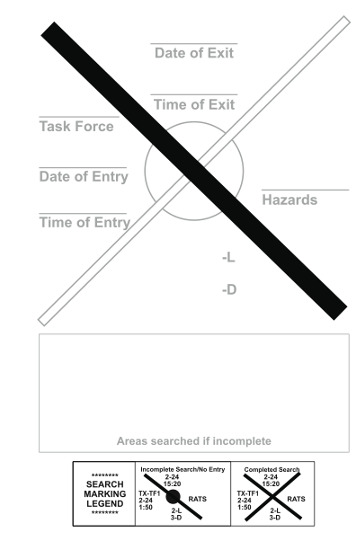
Peel and Stick

Slide 57
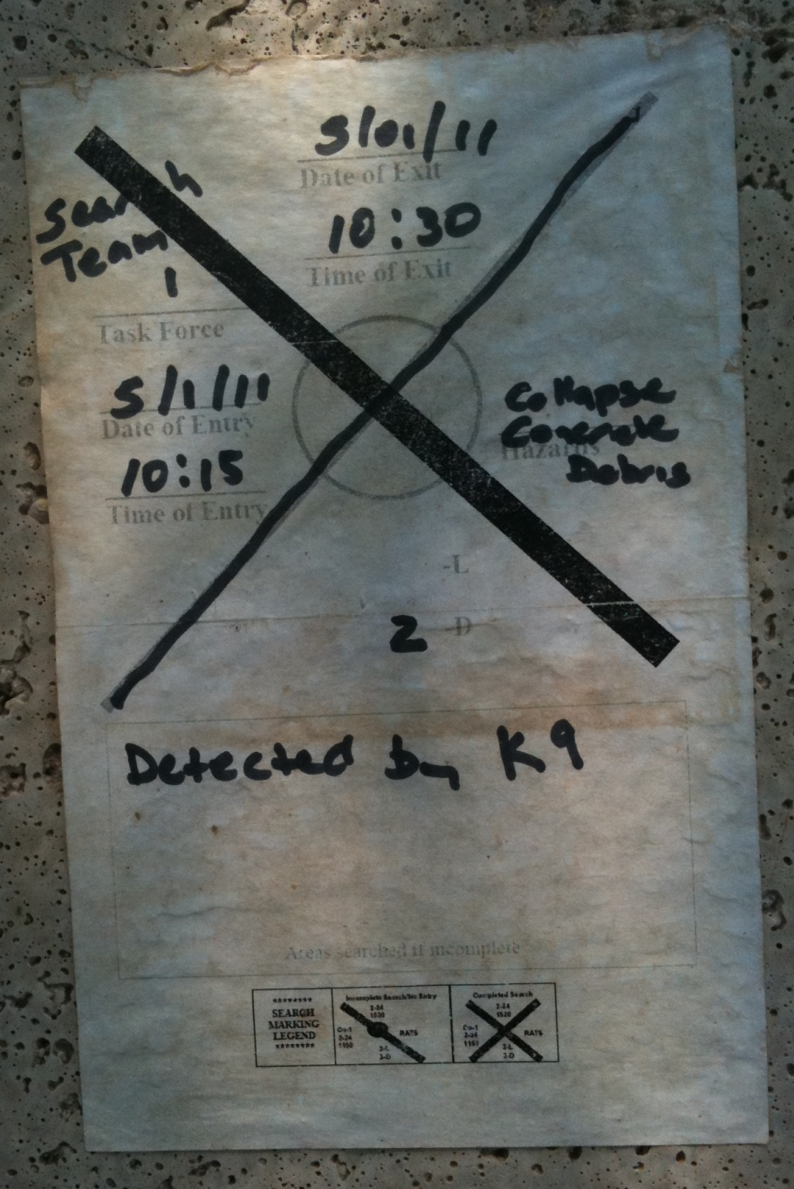
Search Sticker on concrete building.
Note the additional information in the box below the search ‘X’.

Slide 58
Interior Search Markings
(each room or area)
When you ENTER
When you EXIT
Identify any hazards
Identify
any victims

Slide 59
Survivor Markings
SMA
SMA
Confirmed and deceased; If more than one confirmed human remains, place number below V
Potential survivor and team identifier
3
SMA
Confirmed and alive; If more than one survivor, place number below V
SMA
Person has been removed
2
6’
Point toward victim with distance on arrow

Slide 60


Exit
Water
Empty
Water
CA
6
CA
6
CA
6
1 - L
2 - D
Entry
1-12
1500
CA-6
1-12
1300
Water
1-L
2-D
Source Unknown

Slide 61
Summary
SAR responders must have uniform standardized system for marking buildings or other structures to indicate the status of searched structures.
Having a common search marking system reduces the possibility of redundant searches.

